Slide 1

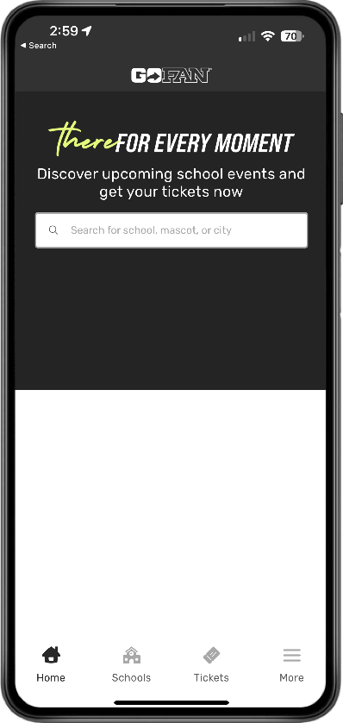

Notes:
DARK BACKGROUND:
Right-click on the example school logo and select Change Picture → From a File.
Select your school logo from your saved files. Be sure to use a PNG file type (transparent background).
Make sure your logo displays properly.
To customize the background color, right-click on the color block on the lower half of the image and select Format Shape → Fill → Solid Fill.
Click the paint can icon and select More Colors.
Click the second icon at the top of the window and select RGB Sliders.
Enter the Hex code of your school color of choice and select OK.
To export the final graphic, click File → Export → JPG.
Now your graphic is ready to post on Facebook, Twitter, Instagram, and other social platforms. Make sure to include the link to your school’s GoFan ticketing page when you post!

Slide 2


Notes:
LIGHT BACKGROUND:
Right-click on the example school logo and select Change Picture → From a File.
Select your school logo from your saved files. Be sure to use a PNG file type (transparent background).
Make sure your logo displays properly.
To customize the background color, right-click on the color block on the lower half of the image and select Format Shape → Fill → Solid Fill.
Click the paint can icon and select More Colors.
Click the second icon at the top of the window and select RGB Sliders.
Enter the Hex code of your school color of choice and select OK.
To export the final graphic, click File → Export → JPG.
Now your graphic is ready to post on Facebook, Twitter, Instagram, and other social platforms. Make sure to include the link to your school’s GoFan ticketing page when you post!

